Slide 1
Using Data Analytics Angular & SpringBoot application with Rapid API
Aysha Fathima Naznin Shafeek
UID:245237 UID:245240

Slide 2
DATA ANALYTICS
Data analytics is the process of examining raw data to uncover patterns, draw conclusions, and make informed decisions. It involves using various techniques and tools to analyze large volumes of data and extract meaningful insights that can be used for business or research purposes.
Data analytics is an interdisciplinary field that combines elements of statistics, mathematics, computer science, and domain expertise.
The primary goal of data analytics is to gain actionable insights from data that can drive better decision-making and improve business outcomes. It involves several stages, including data collection, data cleaning and preprocessing, data modeling and analysis, and data visualization.

Slide 3
Application of Data Analytics in Angular & SpringBoot
User Behavior Tracking: By integrating data analytics tools such as Google Analytics or custom event tracking, you can collect and analyze user behavior data within your Angular and Spring Boot application.
Performance Monitoring: Data analytics can be used to monitor and analyze the performance of your Angular and Spring Boot application. By tracking metrics like response times, server-side processing time, or client-side rendering performance, you can identify bottlenecks, optimize code, and enhance the overall performance and user experience.

Slide 4
3. Error Tracking and Logging: Implementing analytics tools like Sentry or ELK stack (Elasticsearch, Logstash, and Kibana) can help track and analyze errors and exceptions occurring in your Angular and Spring Boot application. This information can help you quickly identify and fix bugs, improve application stability, and enhance user satisfaction.
4.A/B Testing: Data analytics can be leveraged to perform A/B testing in your Angular and Spring Boot application. By collecting user interaction data and analyzing different versions of your application, you can determine which features or designs lead to better user engagement, conversions, or other desired outcomes.

Slide 5
5.Predictive Analytics: By using machine learning algorithms and predictive analytics, you can analyze historical data collected from your Angular and Spring Boot application to make predictions or recommendations. For example, you can use predictive analytics to personalize content, suggest relevant products, or forecast future trends based on user behavior patterns.
6.Real-time Monitoring: With the help of tools like WebSockets or server-sent events, you can push real-time data updates from your Spring Boot backend to the Angular frontend. This enables real-time monitoring and visualization of data analytics metrics, such as live user counts, activity streams, or dynamic dashboards.

Slide 6
DISADVANTAGES
Complexity and learning curve: Implementing data analytics in Angular applications requires additional technical knowledge and expertise. Developers need to understand data analytics concepts, tools, and techniques, which can add complexity to the development process and increase the learning curve for team members who are not familiar with analytics.
Resource-intensive: Data analytics can be resource-intensive, especially when dealing with large volumes of data or complex analytical processes. This can result in increased server load, longer response times, and higher resource consumption, which may impact the overall performance of your Angular application.

Slide 7
Data privacy and security risks: Collecting and analyzing user data for analytics purposes raises privacy and security concerns. It is essential to handle user data responsibly and ensure compliance with relevant data protection regulations. Failure to adequately secure user data can lead to reputational damage and legal implications.
Data quality and reliability: The accuracy and reliability of the data used for analytics can significantly impact the insights and decisions derived from it. Issues such as data inconsistencies, incompleteness, or inaccuracies can lead to flawed analysis and misleading conclusions. Ensuring data quality and maintaining data integrity is crucial for reliable analytics.

Slide 8
Ethical considerations: Data analytics can raise ethical concerns, particularly when it comes to user privacy, data collection practices, and potential biases in the analysis. It is essential to establish clear guidelines and ethical frameworks to govern the use of data analytics in a responsible and transparent manner.
Cost implications: Implementing data analytics solutions often incurs additional costs. These costs can include acquiring analytics tools or platforms, investing in infrastructure and storage, and hiring or training personnel with analytics expertise. Budget constraints may limit the extent to which analytics can be integrated into an Angular application.

Slide 9
Maintenance and updates: Data analytics solutions require ongoing maintenance and updates to stay effective and secure. This involves monitoring data sources, managing data pipelines, ensuring compatibility with evolving Angular versions, and keeping up with changes in data analytics tools and technologies. Failure to maintain and update analytics systems can lead to degraded performance or vulnerabilities.

Slide 10
Rapid API
Rapid API is a platform that provides developers with a marketplace of APIs (Application Programming Interfaces) from various providers. APIs are sets of rules and protocols that allow different software applications to communicate with each other. They enable developers to access and use specific functionalities or data from external services or platforms.
Rapid API acts as an intermediary between API providers and developers, offering a unified interface for discovering, accessing, and managing a wide range of APIs. The platform provides a standardized way for developers to integrate APIs into their applications, regardless of the underlying technologies or programming languages.

Slide 11
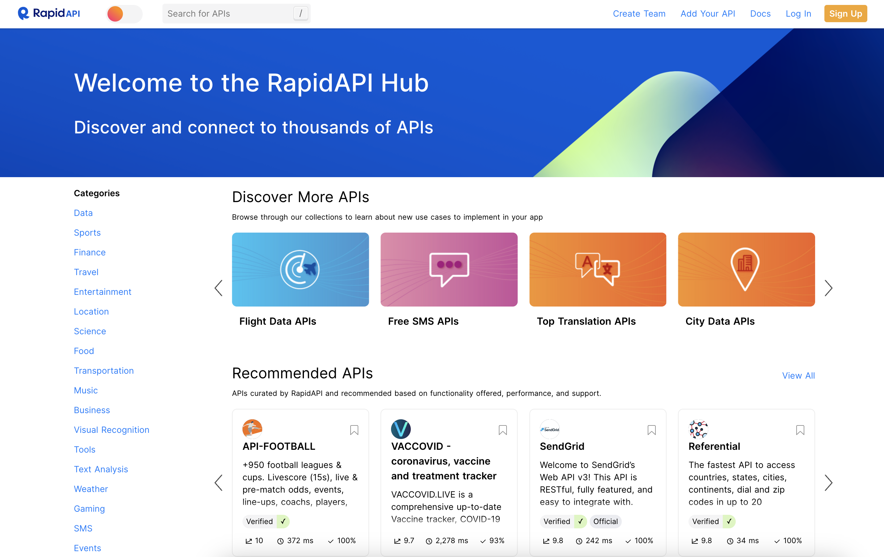

Slide 12
Application of Rapid API
External Service Integration: Angular and Spring Boot applications often require data or functionality from external services like weather data, social media platforms, payment gateways, or geolocation services.
Data Enrichment: Rapid API can be used to enrich the data within an Angular and Spring Boot application. For example, you might need to retrieve additional information about a product, such as product reviews, pricing, or availability from external sources.
Third-Party Integrations: Angular and Spring Boot applications often need to integrate with third-party services such as email providers, SMS gateways, or notification systems.
Microservices Communication: In a microservices architecture, different services may need to communicate with each other to exchange data or trigger actions. Rapid API can be used to integrate APIs between microservices in an Angular and Spring Boot application.
Custom API Aggregation: Rapid API can also be used to create custom APIs that aggregate data or functionalities from multiple APIs.

Slide 13
ADVANTAGES OF RAPID API
Large Variety of APIs: Rapid API provides access to a vast marketplace with thousands of APIs across various categories, including weather, social media, payment processing, machine learning, and more. This wide selection enables developers to easily integrate different functionalities into their applications without having to build everything from scratch.
Simplified Integration: Rapid API simplifies the integration process by providing a unified interface for accessing multiple APIs. Developers can manage and interact with different APIs using a single set of credentials and a consistent API format, which saves time and effort in implementation.

Slide 14
Developer-Friendly Documentation: Rapid API offers comprehensive documentation for each API in their marketplace. This documentation includes clear instructions, sample code, and endpoints, making it easier for developers to understand and use the APIs effectively. This developer-friendly approach reduces the learning curve and enables faster integration.
Standardized API Format: Rapid API follows a standardized format for API endpoints, parameters, and responses across its marketplace. This consistency allows developers to work with different APIs seamlessly, as they don't need to learn unique integration methods for each API they use. It promotes a uniform development experience and streamlines the overall integration process.

Slide 15
Authentication and Billing: Rapid API handles authentication and billing processes for the APIs in their marketplace. Developers only need to authenticate once with Rapid API's credentials and manage billing through their Rapid API account. This centralized authentication and billing system simplify the administrative tasks associated with API usage.​
Monitoring and Analytics: Rapid API provides monitoring and analytics features, allowing developers to track the performance and usage of the APIs integrated into their applications. These insights help identify any issues or bottlenecks and optimize the usage of APIs to enhance the overall application performance.​

Slide 16
Support and Community: Rapid API offers support channels and a developer community where developers can seek assistance, share knowledge, and collaborate with fellow developers. The support team is responsive and can help address any integration or technical issues, ensuring a smoother development process.
Scalability and Reliability: Rapid API's infrastructure is designed to handle high volumes of API requests, ensuring scalability and reliability. Developers can rely on the platform to handle traffic spikes, ensuring that their applications can accommodate increased user demand without sacrificing performance.

